Slide 1
Incomplete alignment

Slide 2
Ei400 vs Ei800 <0,1,0> (ΓH)

Slide 3
Ei400 vs Ei800 <0,1,0> (ΓH)

Slide 4
Spurion?

Slide 5
<1,0,0> (ΓH)

Slide 6
<1,0,0> (ΓH)
Ei=401,[1,y,0]
Ei=401,[x,y,0]
[150-160]
Ei=401,[1,y,0]
Ei=787,[x,y,0]
[150-160]
Ei=787,[1,y,0]
Ei=401,[x,y,0]
[110-120]
Ei=1371,[1,y,0]
Ei=401,[x,y,0]
[120-130]

Slide 7
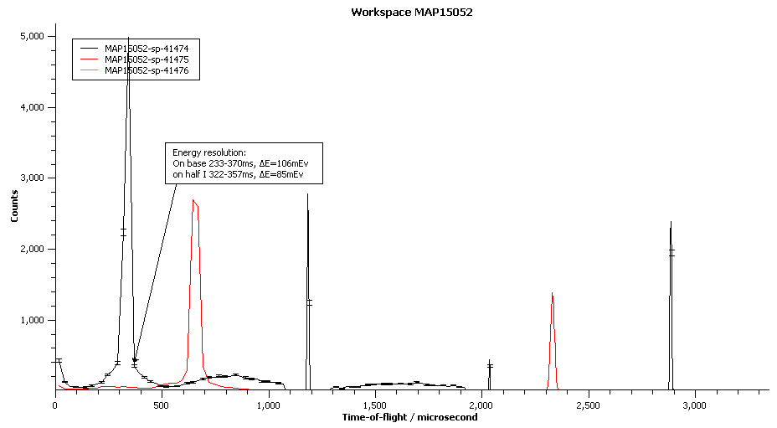
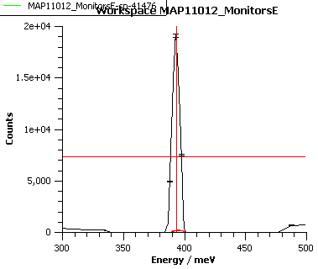
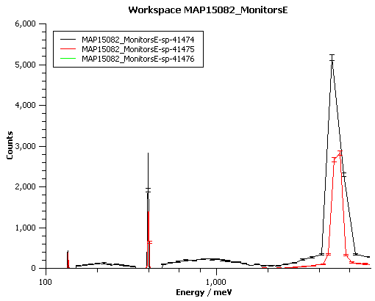
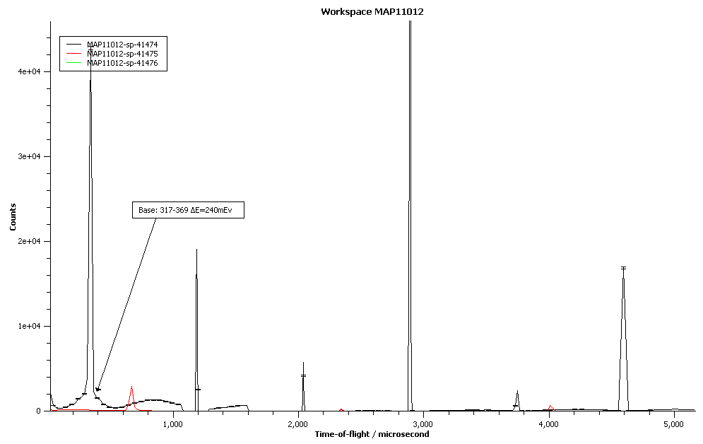
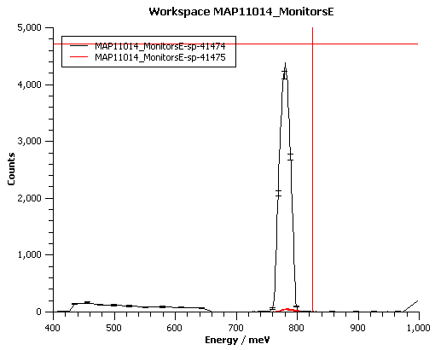
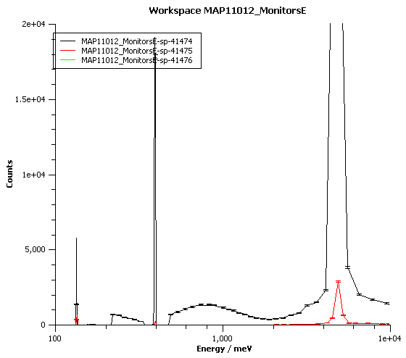
5000mEv
Ei=400meV, monitors
400meV
DE~10mEv=2.5%
Ei=787meV, monitors
ΔE~20mEv=2.5%

Slide 8
Point N -- <1/2,1/2,0> = <1,1,0> in 3.096a^-1
Ei=787
1+x,1-y,0
Ei=1371
1+x,1-y
Ei=787
e=200
+50
Ei=1371
e=200
+50
Ei=787
e=250
+50
Ei=1371
e=250
+50
Ei=1371
e=300
+50
Ei=787
e=300
+50

Slide 9
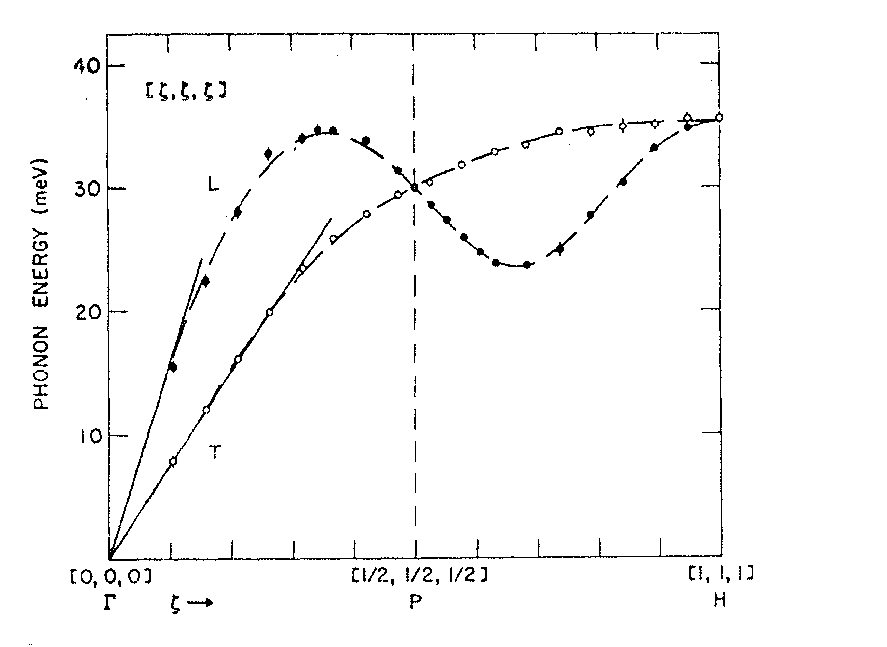
Phonons <111>

Slide 10
P-N?

Slide 11
Mantid vs Libisis – Fe, Ei=400, Psi=-34:

Slide 12
Libisis/Mantid : Cut ratio = 0.88. Is this because of MV
Integral taken from -40 to +40 in Mantid and
-160 to 280 in Libisis?

Slide 13


Slide 14
ALL (1,0,0) (ΓH) E=400
-1,y,0
0,y,0
1,y,0
x,-1,0
x,0,0
x,1,0

Slide 15
ALL (1,0,0) (ΓH) E=400
x,-1,0
x,0,0
x,1,0
x,0,-1
x,0,1
0,y,-1
0,y,0
0,y,1
-1,y,0
1,y,0
1,0,z
0,-1,z

Slide 16
ALL (1,0,0) (ΓH) E=787
x,-1,0
x,0,0
x,1,0
x,0,-1
x,0,1
0,y,-1
-1,y,0
0,y,0
0,y,0
1,y,0
1,0,z
0,1,z

Slide 17
ALL (1,0,0) (ΓH) E=1371
x,-1,0
x,0,0
x,1,0
x,0,-1
x,0,1
0,y,-1
0,y,0
0,y,1
1,y,0
0,-1,z
1,0,z
0,1,z

Slide 18
ALL (1/2,1/2,0) (ΓΝ) E=787
-1,1,0 ->k++
0,0,0 ->k++
1,-1,0 ->k++
0,0,1 ->k++
0,0,-1 ->k++
0,0,1 ->k+-
0,0,0 ->k+-
0,0,-1 ->k+-
1,1,0 ->k+-
(1,1,0)->(-1,0,0)

Slide 19
ALL (1/2,1/2,0) (ΓΝ) E=1371
1,-1,0 ->k++
-1,1,0 ->k++
0,0,0 ->k++
0,0,0 ->k+-
-1,-1,0 ->k+-
1,1,0 ->k+-
Ei=200+20, kx=1
Ei=220+20, kx=1
Ei=240+40, kx=1
The reason for increase
in intensity in this area

Slide 20
ALL (1,0,0) (ΓH) E=400
BZ (-2,0,0)
BZ (0,2,0)
BZ (0,-2,0)
k->0,0,1
k->0,1,0
k->1,0,0
BZ (2,0,0)
k->0,0,1
BZ (-1,-1,0)
k->1,0,0
k->0,1,0
k->0,0,1
BZ (-1,1,0)
BZ (-1,0,-1)
k->1,0,0
k->0,1,0
k->0,1,0

Slide 21
ALL (1,0,0) (ΓH) E=400
BZ (-1,0,1)
BZ (0,-1,-1)
k->0,1,0
k->0,0,1
k->1,0,0
BZ (0,-1,-1)
BZ (0,1,-1)
k->0,1,0
k->1,0,0
k->0,0,1
BZ (0,-1,1)
k->1,0,0
k->0,1,0
k->0,0,1
BZ (0,1,1)
k->1,0,0
k->0,1,0
k->0,0,1

Slide 22
ALL (1,0,0) (ΓH) E=400
BZ (1,-1,0)
k->1,0,0
k->0,1,0
k->0,0,1
BZ (1,1,0)
k->1,0,0
k->0,1,0
k->0,0,1
BZ (1,0,-1)
k->1,0,0
k->0,1,0
k->0,0,1
BZ (1,0,1)
k->1,0,0
k->0,1,0
k->0,0,1

Slide 23
ALL (1/2,1/2,0) (ΓΝ) E=400
BZ -2,0,0
K->1,1,0
K->1,-1,0
K->-1,1,0
K->0,1,1
K->0,1,-1
K->0,-1,1
BZ 0,-2,0

Slide 24
NH Some (1/2,1/2,0)->(1,0,0), Brag at 0.707 E=400
BZ 0,-2,0; edge (-1,0,1)
BZ 0,-2,0; edge (1,1,0) –BUG?
BZ 2,0,0; edge (-1,1,0)
BZ -1,-1,0; edge (-1,0,-1)

